Slide 1
Lecture 4: CNN: Optimization Algorithms
boris. ginzburg@intel.com

Slide 2
Agenda
Gradient-based learning for Convolutional NN
Stochastic gradient descent in caffe
Learning rate adaptation
Momentum and weight decay
SGD with line search
Newton methods;
Conjugate Gradient
Limited memory BFGS (L-BFGS)
Imagenet training

Slide 3
Links
LeCun et all “Efficient Backpropagation “ http://cseweb.ucsd.edu/classes/wi08/cse253/Handouts/lecun-98b.pdf
Le, Ng et all “On Optimization Methods for Deep Learning“ http://cs.stanford.edu/people/ang/?portfolio=on-optimization-methods-for-deep-learning
Hinton Lecture https://www.cs.toronto.edu/~hinton/csc2515/notes/lec6tutorial.pdf
++
http://yann.lecun.com/exdb/publis/pdf/lecun-01a.pdf
http://www.iro.umontreal.ca/~pift6266/H10/notes/gradient.html#flowgraph
Bottou Stochastic Gradient Descent Tricks http://research.microsoft.com/pubs/192769/tricks-2012.pdf

Slide 4
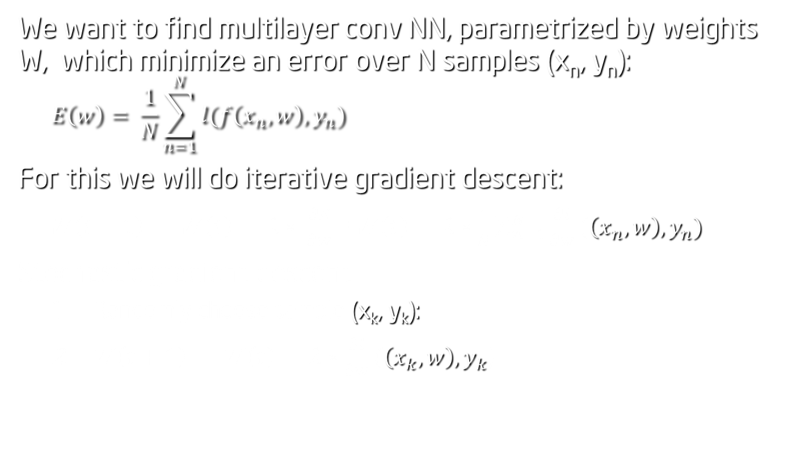
Gradient descent
We want to find multilayer conv NN, parametrized by weights W, which minimize an error over N samples (x_{n}, y_{n}):
$$E\left(w\right)= \frac{1}{N}\sum_{n=1}^{N}{l(f\left(x_{n}, w\right), y_{n})}$$
For this we will do iterative gradient descent:
$W\left(t+1\right)= W\left(t\right) −λ∗ \frac{∂E}{∂w}$= $W\left(t\right) −λ∗\frac{1}{N}\sum_{n=1}^{N}{\frac{∂l}{∂w}(\left(x_{n}, w\right),y_{n})}$
Stochastic gradient descent:
Randomly choose sample (x_{k}, y_{k}):
$W\left(t+1\right)= W\left(t\right) −λ∗\frac{∂l}{∂w}(\left(x_{k}, w\right),y_{k}$)

Slide 5
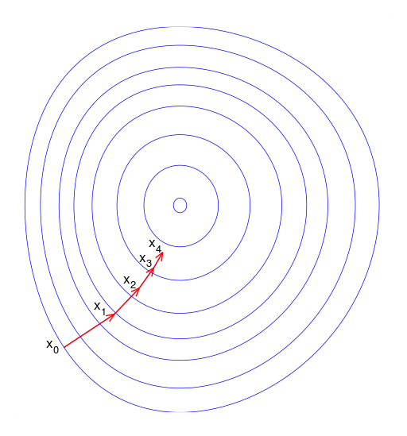
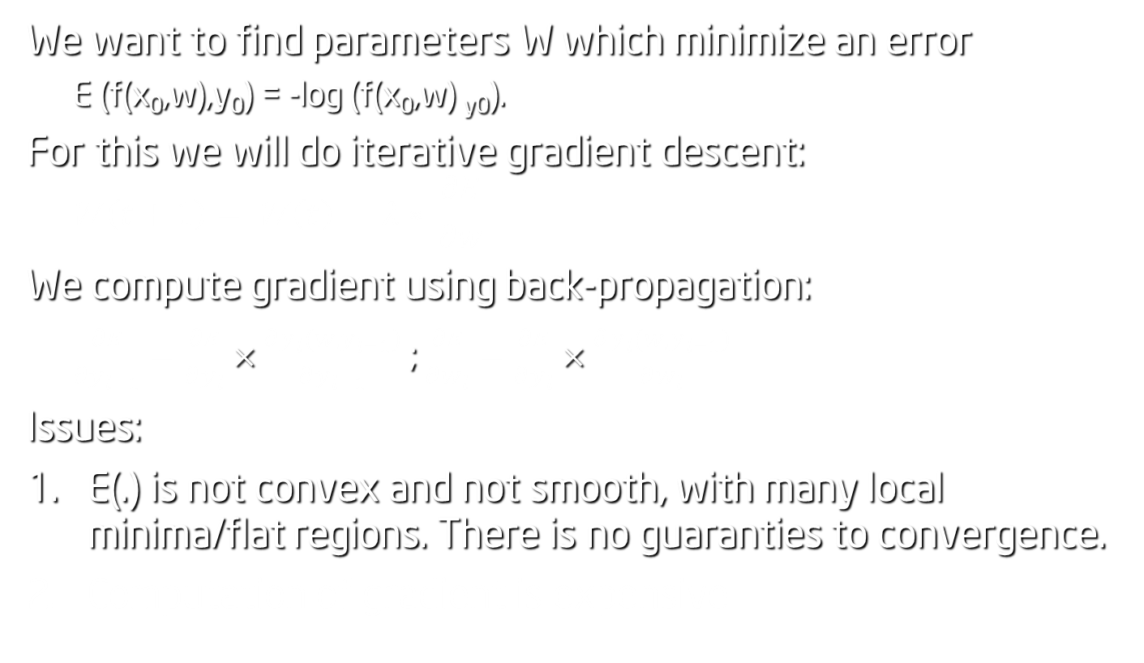
Gradient based training
We want to find parameters W which minimize an error
E (f(x₀,w),y₀) = -log (f(x₀,w) _{y0}).
For this we will do iterative gradient descent:
$$W\left(t+1\right)= W\left(t\right) −λ∗ \frac{∂E}{∂w}$$
We compute gradient using back-propagation:
$\frac{∂E}{∂y_{l−1}}=\frac{∂E}{∂y_{l}}×\frac{∂y_{l}(w,y_{l−1})}{∂y_{l−1}}$ ; $\frac{∂E}{∂w_{l}}=\frac{∂E}{∂y_{l}}×\frac{∂y_{l}(w,y_{l−1})}{∂w_{l}}$
Issues:
E(.) is not convex and not smooth, with many local minima/flat regions. There is no guaranties to convergence.
Computation of gradient is expensive.

Slide 6
Stochastic Gradient Descent with mini-batches
Stochastic Gradient Descent:
divide the dataset into small batches of examples,
compute the gradient using a single batch, make an update, or do line-search
move to the next batch of examples…
Key parameters :
size of mini-batch
number of iteration per mini-batch
Mini-batches:
choose samples from different classes

Slide 7
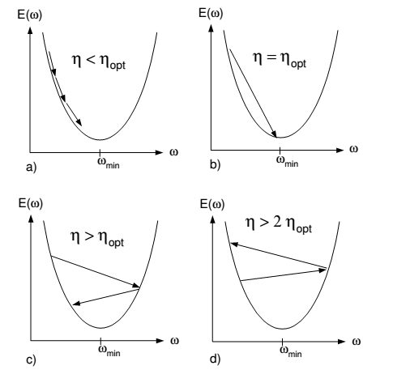
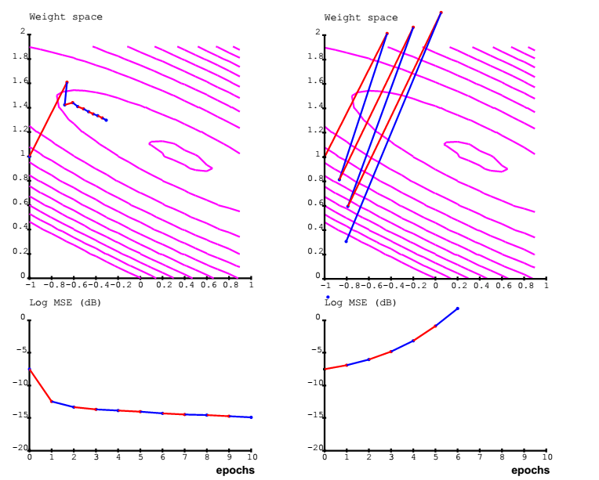
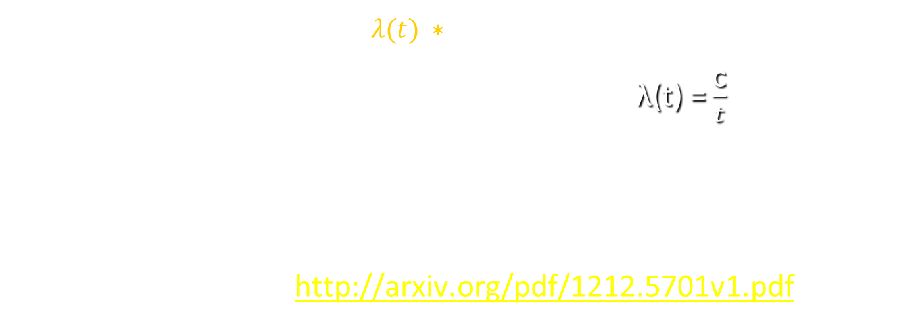
Learning Rate adaptation
$W\left(t+1\right)= W\left(t\right) −λ(t) ∗ \frac{∂E}{∂w}$
Decrease learning rate (“annealing”), e.g. $\text{λ}\text{(}\text{t}\text{) =}\frac{\text{c}}{t}$; usually $\sum_{t=1}^{∞}{\frac{1}{λ^{2}(t)}<∞}$ ; and $\sum_{t=1}^{∞}{\frac{1}{λ(t)}=∞}$
Choose different learning rate per layer:
λ is ~to square root of # of connections which share weights
See Zeiler Adadelta: http://arxiv.org/pdf/1212.5701v1.pdf

Slide 8
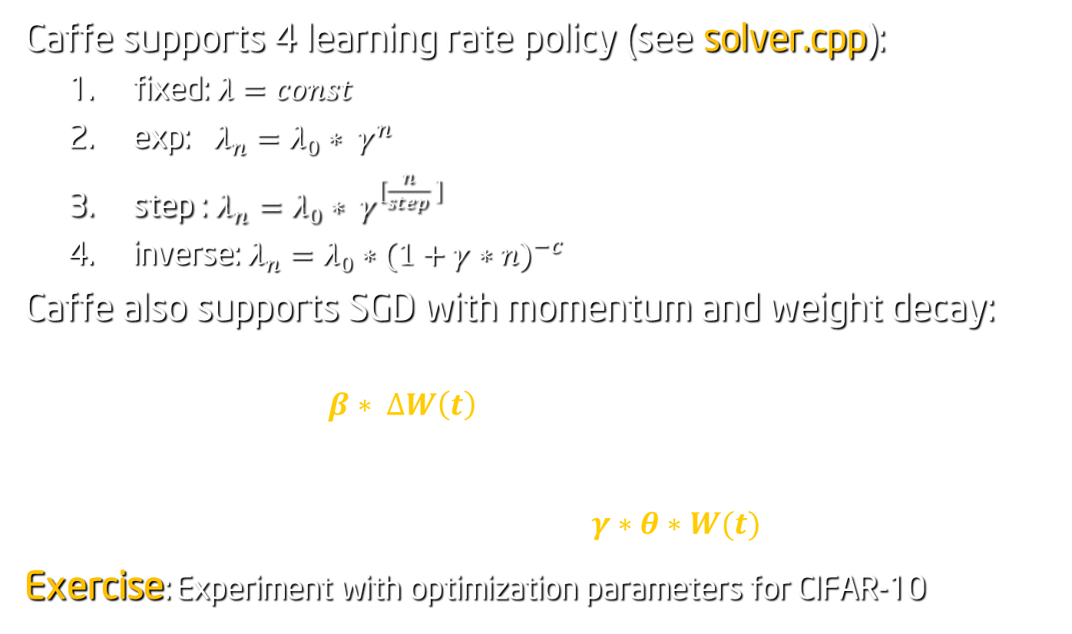
Caffe: learning rate adaptation
Caffe supports 4 learning rate policy (see solver.cpp):
fixed: $λ=const$
exp: $λ_{n}=λ_{0}∗ γ^{n}$
step : $λ_{n}=λ_{0}∗ γ^{[\frac{n}{step} ]}$
inverse: $λ_{n}=λ_{0}∗{(1+γ∗n)}^{−c}$
Caffe also supports SGD with momentum and weight decay:
momentum: $∆W\left(t+1\right)=β∗ ∆W\left(t\right)+\left(1−β\right)∗(−γ∗ \frac{∂E}{∂w}$ ),
weight decay (regularization of weights) :
$W\left(t+1\right)=\left( W\left(t\right)−γ∗ \frac{∂E}{∂w} \right)−γ∗θ∗W(t)$
Exercise: Experiment with optimization parameters for CIFAR-10

Slide 9
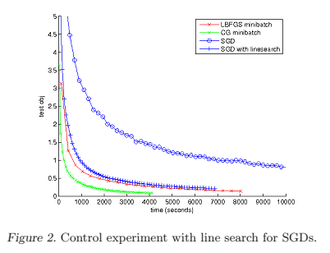
Going beyond SGD
See Le at all “On Optimization Methods for Deep Learning”

Slide 10
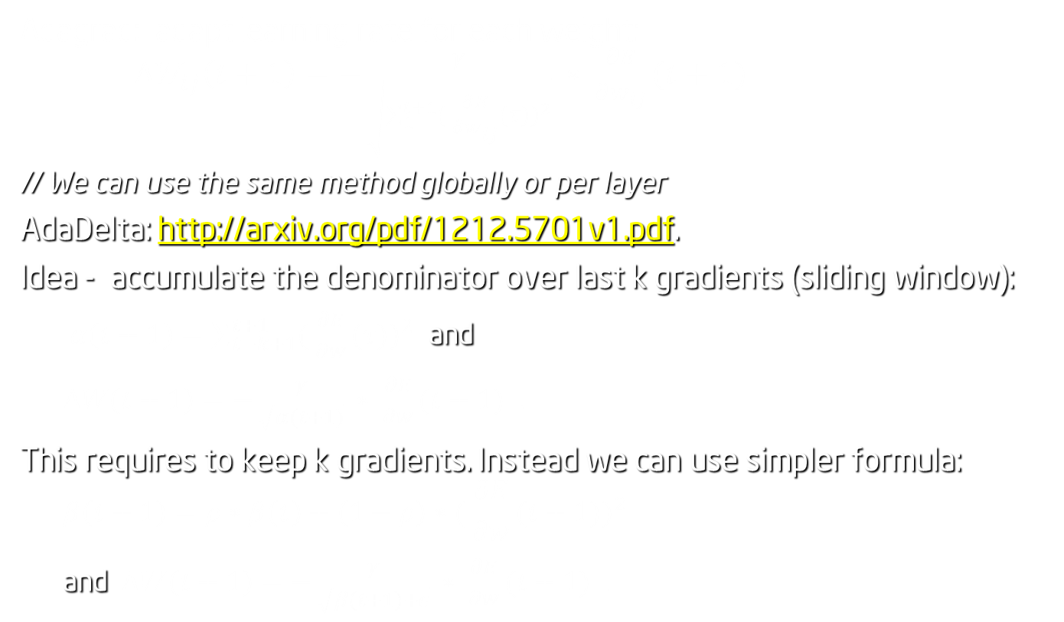
AdaGrad/AdaDelta
Adagrad: adapt learning rate for each weight: $∆W_{ij}\left(t+1\right)=−\frac{γ}{\sqrt{\sum_{1}^{t+1}{( {\frac{∂E}{∂w_{ij}}(τ))}^{2}}}} ∗ \frac{∂E}{∂w_{ij}}(t+1)$
// We can use the same method globally or per layer
AdaDelta: http://arxiv.org/pdf/1212.5701v1.pdf.
Idea - accumulate the denominator over last k gradients (sliding window):
$α\left(t+1\right)=\sum_{t−k+1}^{t+1}{( {\frac{∂E}{∂w}(τ))}^{2}}$ and
$∆W\left(t+1\right)=−\frac{γ}{\sqrt{α(t+1)}} ∗ \frac{∂E}{∂w}(t+1)$ .
This requires to keep k gradients. Instead we can use simpler formula:
$$β\left(t+1\right)=ρ∗β\left(t\right)+\left(1−ρ\right)∗( {\frac{∂E}{∂w}(t+1))}^{2}$$
and $∆W\left(t+1\right)=−\frac{γ}{\sqrt{β\left(t+1\right)+ε}} ∗ \frac{∂E}{∂w}(t+1)$ .

Slide 11
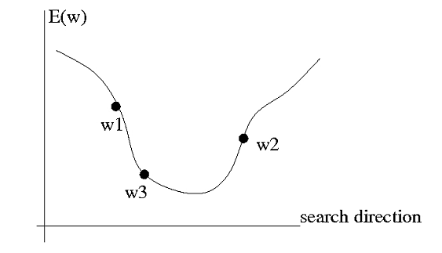
SGD with Line search
Gradient computation is ~ 3x time more expensive than Forward(. ). Rather than take one fixed step in the direction of the negative gradient or the momentum-smoothed negative gradient, it is possible to do a search along that direction to find the minimum of the function:

Slide 12
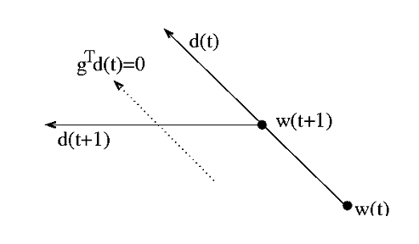
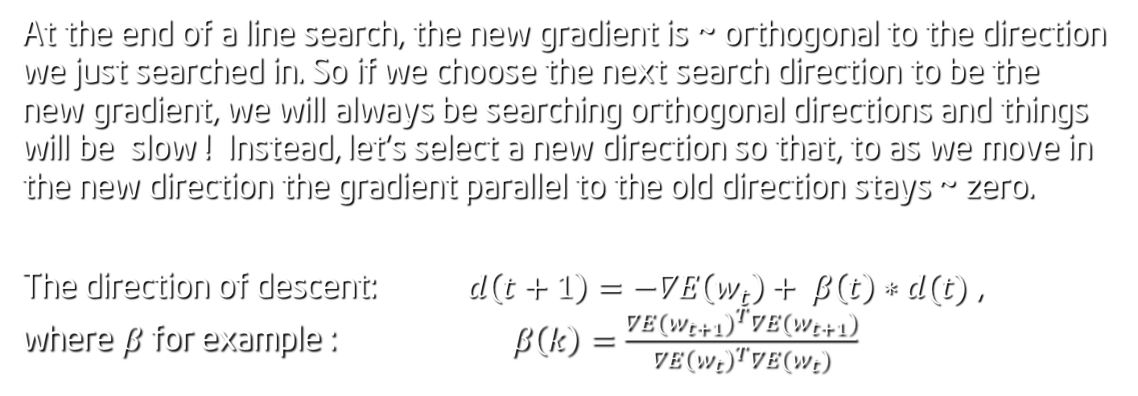
Conjugate Gradient
At the end of a line search, the new gradient is ~ orthogonal to the direction we just searched in. So if we choose the next search direction to be the new gradient, we will always be searching orthogonal directions and things will be slow ! Instead, let’s select a new direction so that, to as we move in the new direction the gradient parallel to the old direction stays ~ zero.
The direction of descent: $d\left(t+1\right)=−∇E\left(w_{t}\right)+ β\left(t\right)∗d(t)$ , where $β$for example : $β\left(k\right)=\frac{{∇E(w_{t+1})}^{T}∇E(w_{t+1})}{{∇E\left(w_{t}\right)}^{T}∇E(w_{t})}$

Slide 13
Stochastic Diagonal Levenberg-Marquardt

Slide 14
Imagenet Training
ILSVRC uses a subset of ImageNet DB with roughly 1000 images in each of 1000 categories. In all, there are ~ 1.2 million training images, 50,000 validation images, and 150,000 testing images.
Read LSVRC competition rules: http://www.image-net.org/challenges/LSVRC/2014/ http://image-net.org/challenges/LSVRC/2012/
do Imagenet tutorial following the tutorial: http://caffe.berkeleyvision.org/gathered/examples/imagenet.html The data is already pre-processed and stored in leveldb, so you can start with ./train_imagenet.sh

Slide 15
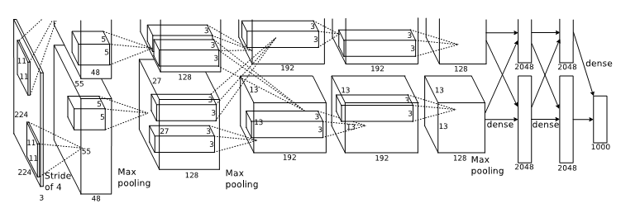
AlexNet
Alex K. train his net using two GTX-580 with 3 GB memory. To overcome this limit, he divided work between 2 GPU-s . It took 6 days to train the net: www.cs.toronto.edu/~fritz/absps/imagenet.pdf
Can you train the net with the same performance in 1 day using one Titan Black?

Slide 16

AlexNet Parameters
batch size of 128 examples,
momentum of 0.9,
weight decay of 0.0005.
Weight initialization: a zero-mean Gaussian distribution with standard deviation 0.01.
learning rate:
The same for all layers,
The learning rate was initialized at 0.01 and adjusted manually throughout training: The heuristic which we followed was to divide the learning rate by 10 when the validation error rate stopped improving with the current learning rate
Dropout for fully connected layer (will discuss tomorrow)
90 epochs through whole image dataset.

Slide 17
Exercises
Exercise :
Read Alex K. paper: http://www.cs.toronto.edu/~fritz/absps/imagenet.pdf
Train Imagenet. How good you can get till tomorrow 9am?
Projects:
Add to caffe:
line-search , CGD, Adagrad/AdaDelta (http://arxiv.org/pdf/1212.5701v1.pdf )

